Slide 1




Viewing historical requests
Yoel Kortick. Senior Librarian
https://www.askideas.com/20-amazing-sunset-view-pictures-and-images-of-charles-bridge/

Slide 2
Viewing Historical Requests in the Resource Request Monitor
The Resource Request Monitor displays historical requests, including completed, canceled, and rejected requests.
The Activity Status filter was added at the top of the page to allow the staff user to display only active requests, completed requests, or both.
The date facets on the page are unavailable when filtering on “All” or “Completed.”

Slide 3
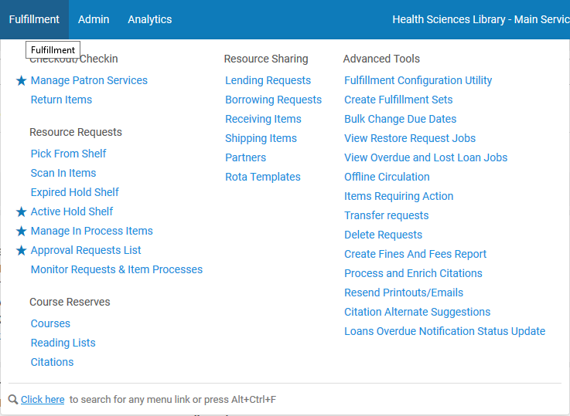
Viewing Historical Requests in the Resource Request Monitor
Access the Resource Request Monitoring page

Slide 4
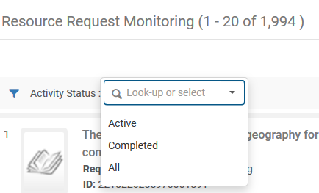
Viewing Historical Requests in the Resource Request Monitor
The Activity Status filter was added at the top of the page to allow the staff user to display only active requests, completed requests, or both.

Slide 5
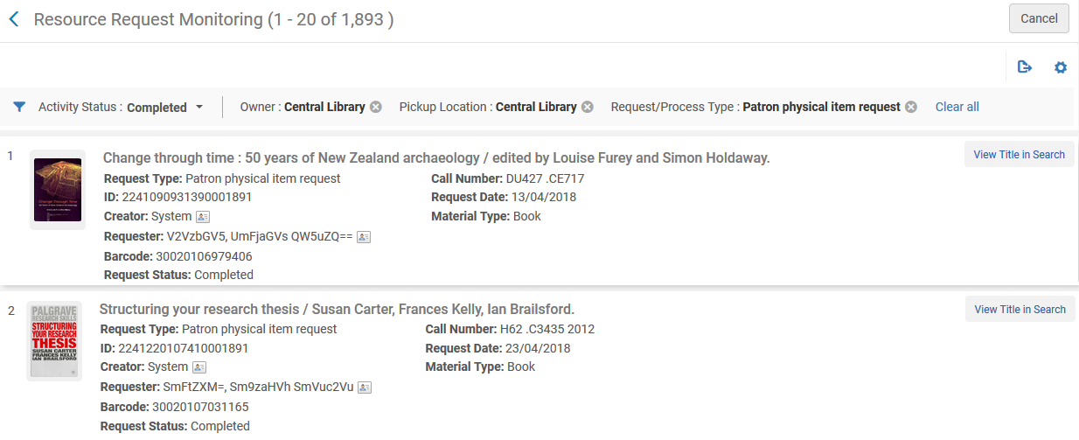
Viewing Historical Requests in the Resource Request Monitor
For example here we have filtered and faceted for all patron physical item requests owned by the Central Library for pickup at the Central library.

Slide 6
Viewing request history for an item retrieved in search results
In addition to the April 2018 feature allowing the staff user to view historical requests in Resource Request Monitoring, in the May 2018 release it is also possible view request history for an item retrieved in search results.

Slide 7
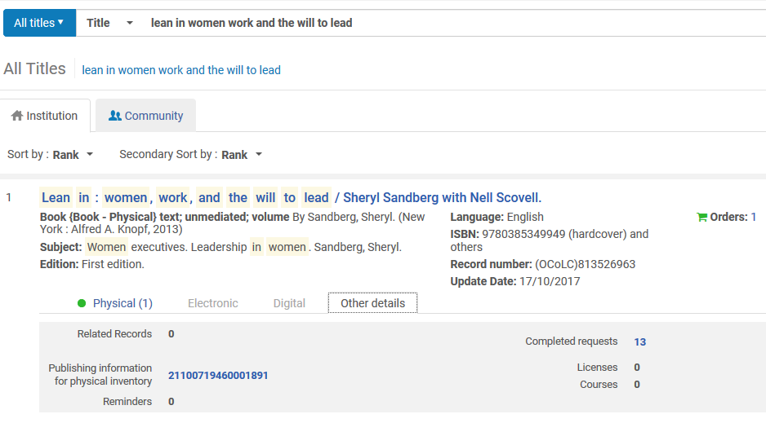
Viewing request history for an item retrieved in search results
For example here is the “Other details” section of an “All titles” search for title “Lean in: women, work and the will to lead”

Slide 8
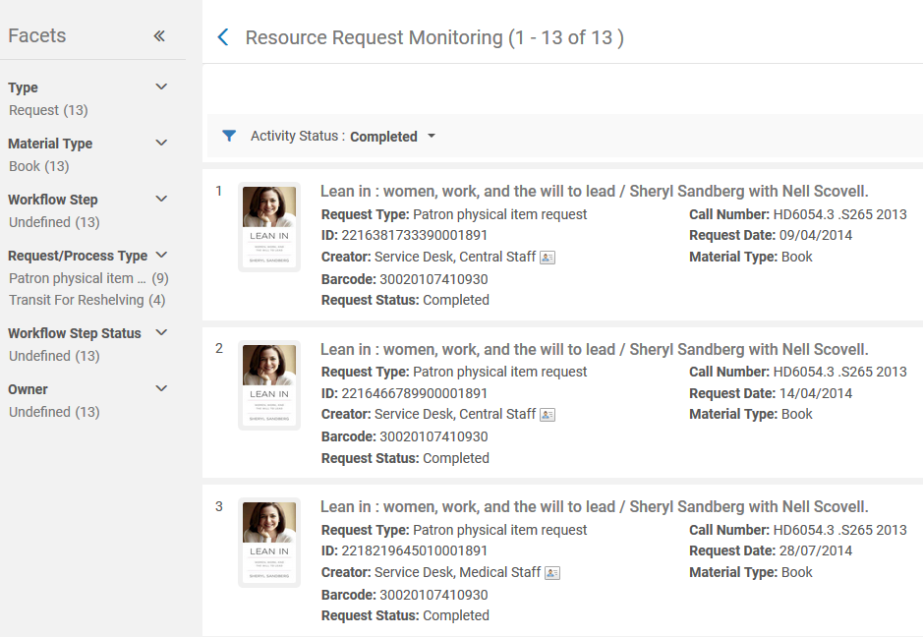
Viewing request history for an item retrieved in search results
Clicking the “completed requests” link brings the staff user to the “Resource Request Monitoring” page

Slide 9
Thank You
Yoel.Kortick@exlibrisgroup.com
https://www.askideas.com/20-amazing-sunset-view-pictures-and-images-of-charles-bridge/

